Slide 1
Ideation and Design
SE495: Software Entrepreneurship

Slide 2
Outline
Overview
Understanding the Problem
Techniques for Generating Ideas
Design Thinking
User Experience (UX) Design

Slide 3
Overview

Slide 4
Why are they important?
Ideation: generating innovative ideas for software products/services
Design: creating a user-friendly and visually appealing interface
Importance: critical for software entrepreneurship success

Slide 5
Ideation
Generate innovative ideas for software products/services
Identify problems and opportunities in the market
Develop solutions that address customer needs
Differentiate from competitors
Create a unique value proposition

Slide 6
Design
Create an intuitive and user-friendly interface
Ensure a seamless user experience
Increase customer satisfaction and loyalty
Enhance the overall brand experience
Improve the software's accessibility and usability

Slide 7
Driving Success in Software Entrepreneurship
Ideation and design are crucial for software entrepreneurship success
They enable the creation of innovative and user-friendly software products/services
By combining ideation and design, software entrepreneurs can differentiate their products/services and gain a competitive edge in the market
Investing in ideation and design can lead to increased customer satisfaction, loyalty, and ultimately, business growth and success.

Slide 8
Understanding the Problem

Slide 9
The First Step in Software Entrepreneurship
Understanding the problem is the first step in software entrepreneurship
It involves identifying pain points and opportunities in the market
And understanding the user's needs and problems

Slide 10
Identifying Pain Points and Opportunities
Conduct market research to identify pain points and opportunities
Analyze industry trends, customer needs, and emerging technologies
Look for areas where existing solutions are lacking or inefficient
Identify potential opportunities for innovation and disruption

Slide 11
Identifying Pain Points and Opportunities
"Food Delivery App“, Pain Point: Ordering Food Hassle
Opportunity: Streamlining Food Delivery
Identifying the Pain Point
One common pain point in the food industry is the hassle of ordering food. Customers often face challenges such as long waiting times, busy phone lines, and miscommunication with restaurants when placing orders. This creates frustration and inconvenience for both customers and restaurant owners.
Researching the Pain Point
Conduct market research to gather data and insights about the pain point. Interview potential customers, observe their behavior, and analyze existing food delivery services to understand the specific pain points experienced by users. This research will help validate the magnitude and impact of the identified pain point.

Slide 12
Identifying Pain Points and Opportunities
"Food Delivery App“, Pain Point: Ordering Food Hassle
Identifying Opportunities: Based on the pain point, you can brainstorm potential opportunities for a software solution that addresses the ordering hassle. Here are a few possibilities:
Mobile App with User-Friendly Interface:
Develop a mobile application that allows users to browse menus, place orders, and track deliveries easily. The app should have a user-friendly interface, enabling customers to navigate through various options effortlessly.
Integration with Multiple Restaurants:
Offer a platform that integrates with multiple restaurants, allowing customers to access a wide range of menus and cuisines in one place. This would save customers from the hassle of searching for individual restaurants and menus.
Real-Time Order Tracking:
Implement a real-time order tracking feature, enabling customers to track the progress of their orders from the restaurant to their doorstep. This would provide transparency and peace of mind to customers.
Customization and Personalization:
Provide options for customization and personalization, such as dietary preferences, allergies, and ingredient substitutions. This would cater to the diverse needs of customers, enhancing their overall experience.

Slide 13
Identifying Pain Points and Opportunities
"Food Delivery App“, Pain Point: Ordering Food Hassle
Validating the Opportunities:
Once potential opportunities are identified, conduct further research to validate their feasibility and potential market demand. This may involve surveying potential customers, conducting focus groups, or analyzing competitor offerings to ensure the viability of the proposed software solution.

Slide 14
Market Segmentation
It is the process of dividing a market into smaller groups of consumers with similar needs or characteristics.
It is important since it is key in understanding the market and identifying the target audience.
The objective is to identify the specific groups of consumers that your software product will target.

Slide 15
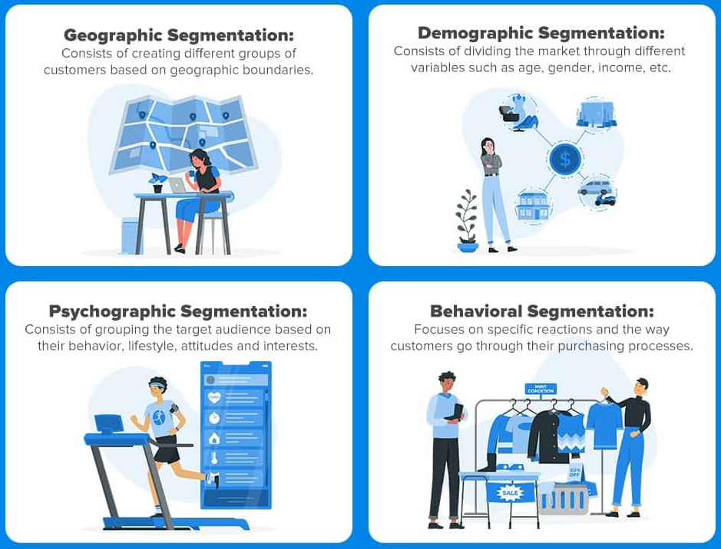
Market Segmentation
Types of Market Segmentation

Slide 16
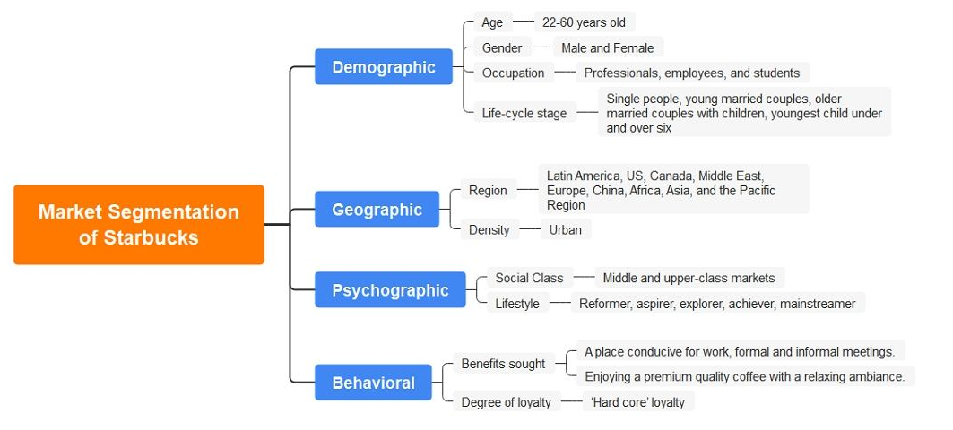
Market Segmentation

Slide 17
Market Segmentation
Steps for Conducting Market Segmentation
1: Define the market
2: Identify the criteria
3: Group the market
4: Analyze the segments
5: Choose the target segment

Slide 18
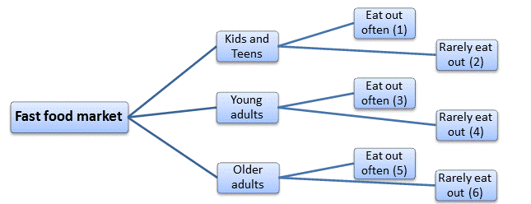
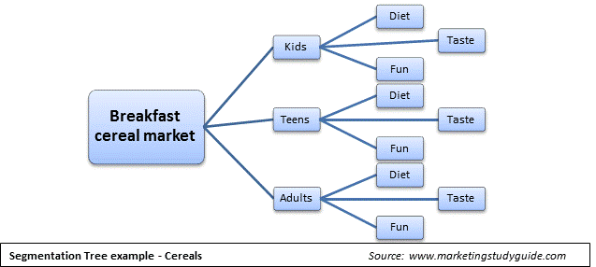
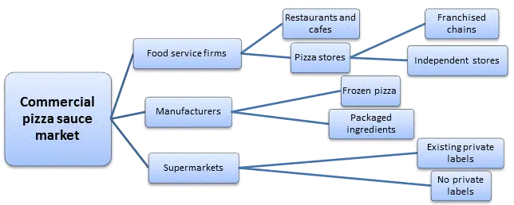
Market Segmentation

Slide 19
Market Positioning
It is the process of identifying and communicating the unique value of your product or service in the market.
It is important since it helps in understanding your target audience, differentiate your product from competitors, and ultimately, attract the right customers.

Slide 20
Market Positioning
Identifying your target audience:
Demographics (age, gender, income, etc.)
Psychographics (values, interests, lifestyle, etc.)
Pain points and needs
Understanding your target audience's behavior:
How they make purchasing decisions
What influences their decisions
Their preferred communication channels

Slide 21
Market Positioning
A unique value proposition (UVP) is a statement that clearly communicates the unique benefits of your product or service.
Key elements of a UVP:
A clear and concise statement
Highlights the unique benefits of your product/service
Differentiates your product/service from competitors
Speaks to the needs and pain points of your target audience
Examples of UVPs:
"Our product is the only one that combines AI technology with human expertise to provide personalized financial advice."
"Our service offers a seamless, end-to-end project management solution that saves time and reduces costs."

Slide 22
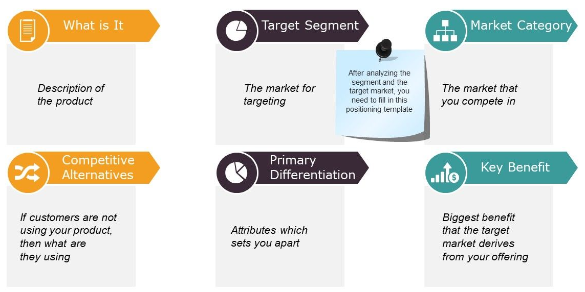
Market Positioning

Slide 23
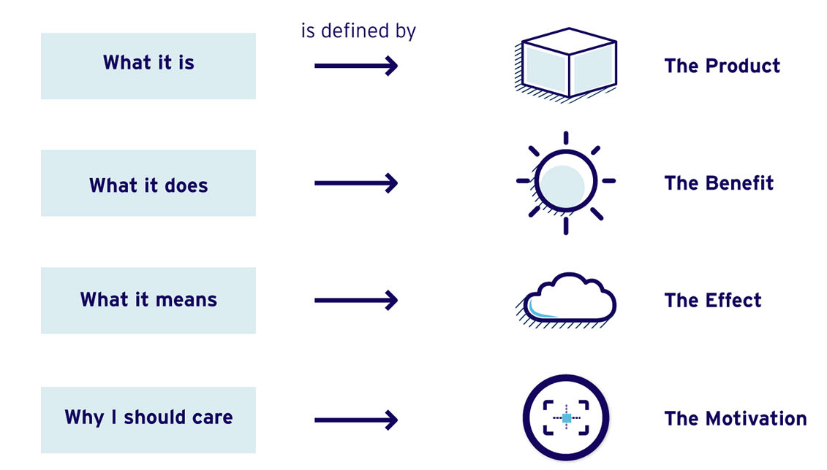
From Positioning to Communication

Slide 24
Understanding User Needs and Problems
Understand the user's needs, goals, and pain points
Identify the user's workflows, behaviors, and motivations
Develop user personas and user journey maps
Use empathy and user feedback to guide product development

Slide 25
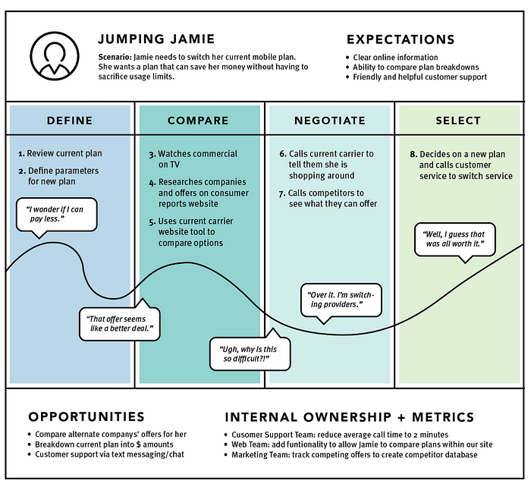
User journey maps are a visual representation of the steps a user takes when interacting with a product, service, or system.
It's a tool used in software entrepreneurship and ideation and design to understand the user's experience and identify opportunities for improvement.

Slide 26
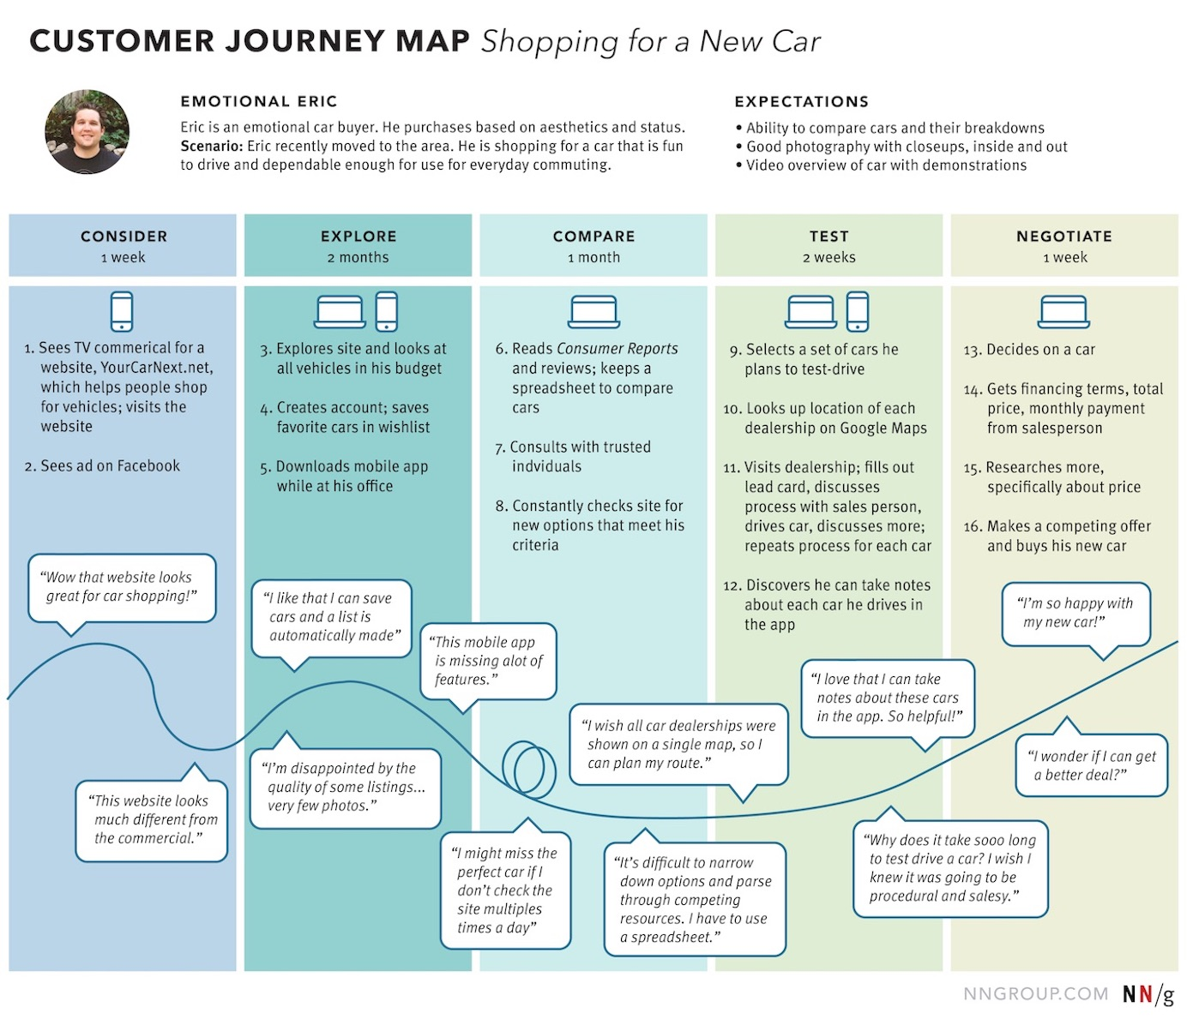

Slide 27
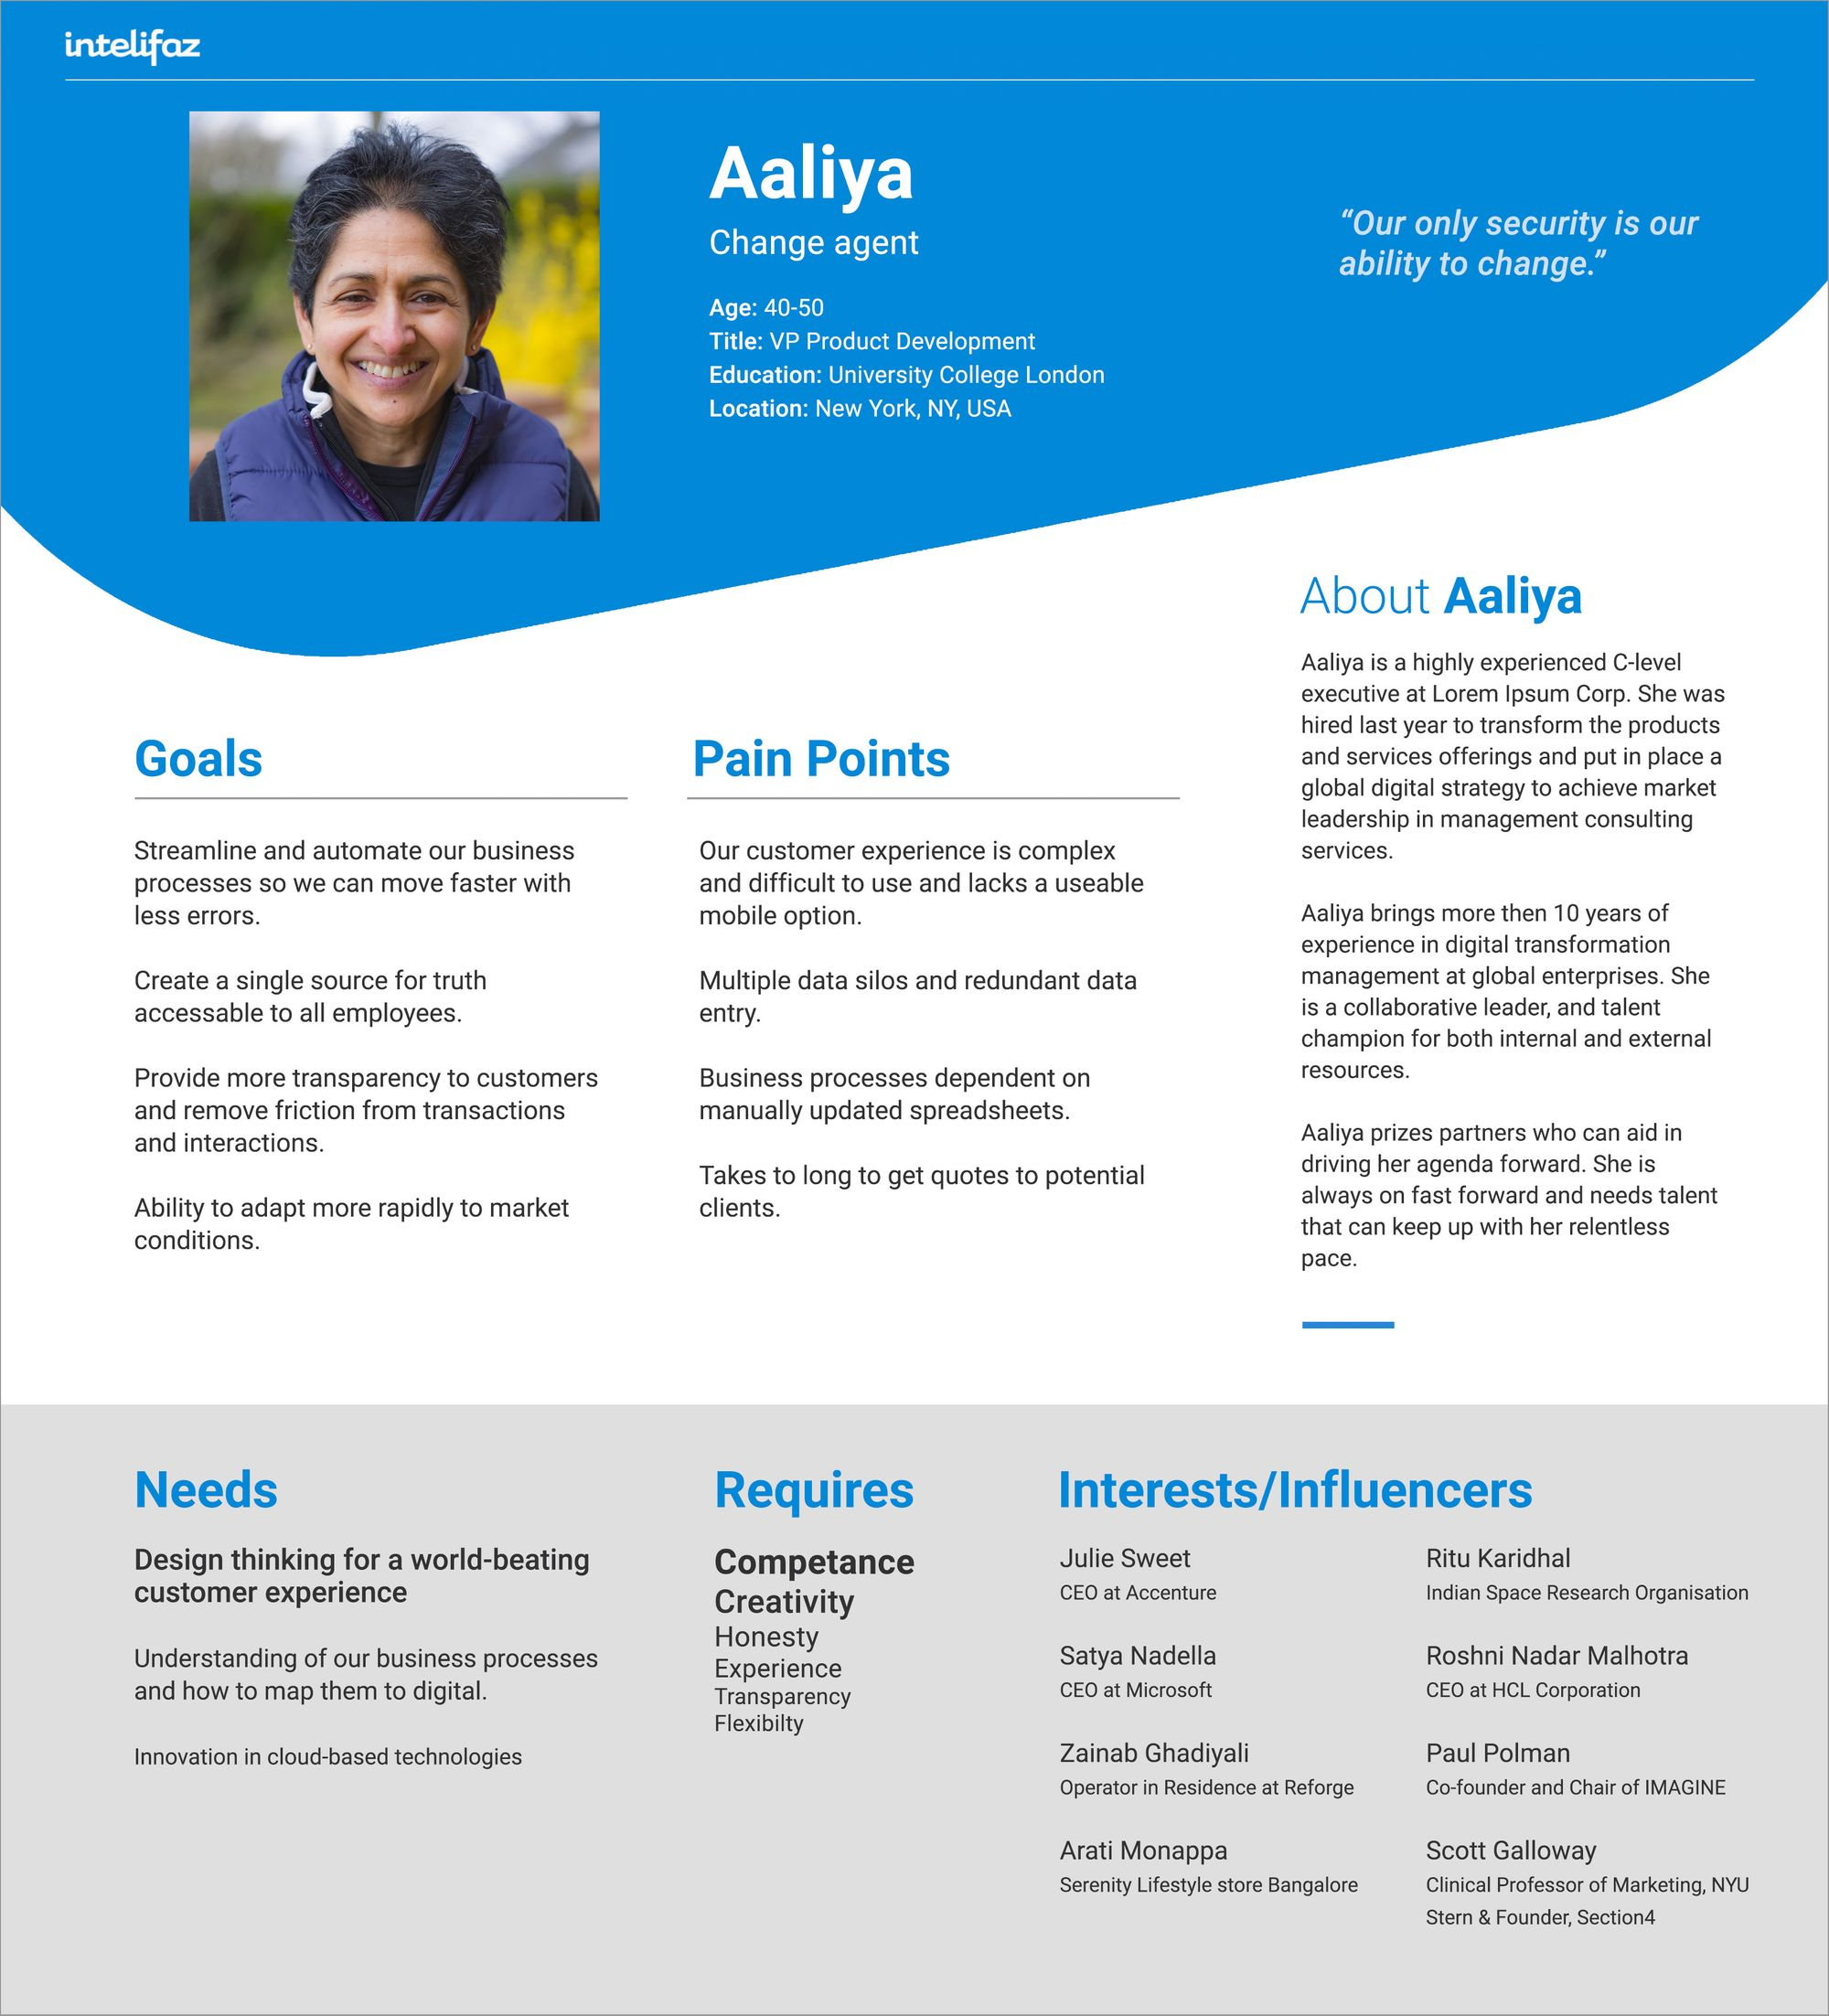
User personas are fictional characters created to represent the different types of users who will interact with a product or service.
These personas are based on market research and user data, and are used to help software entrepreneurs and designers understand the needs, goals, and behaviors of their target audience.

Slide 28
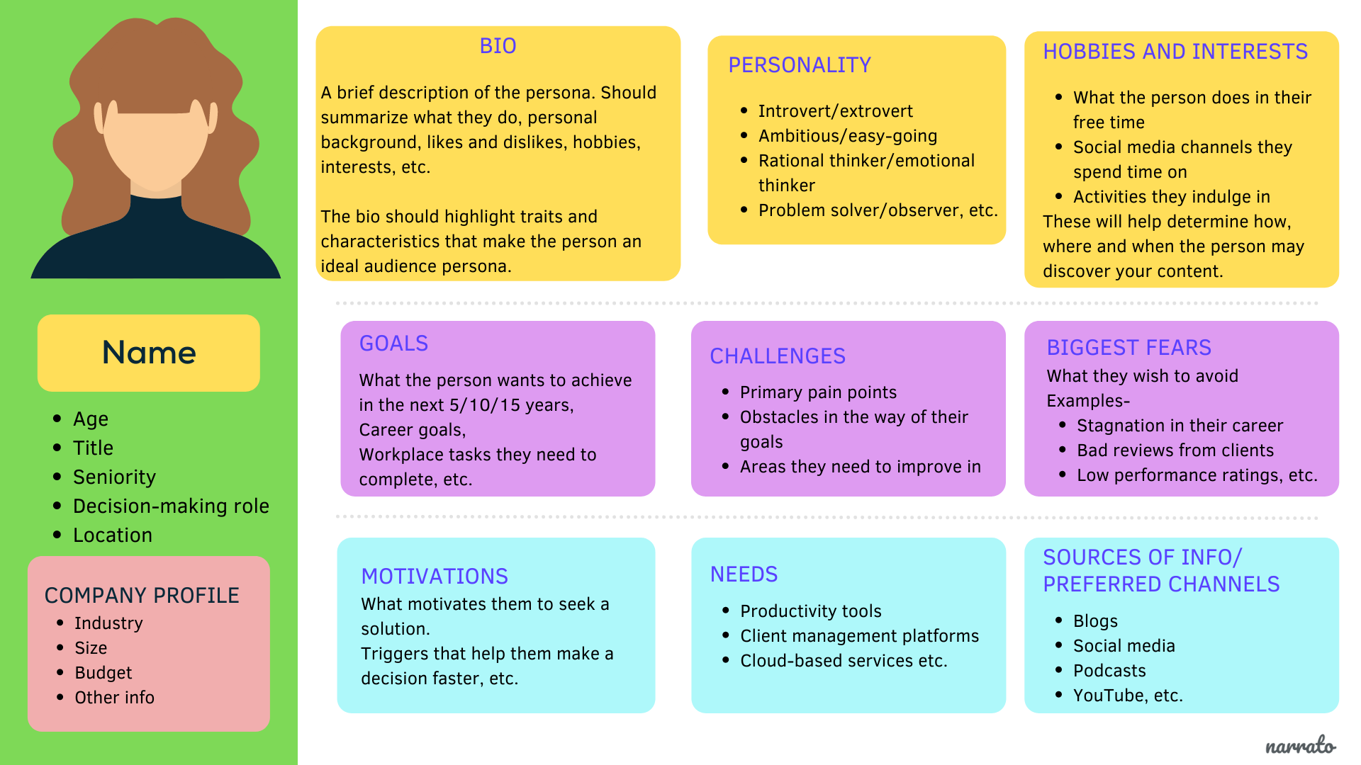

Slide 29
Methods for Understanding Users
Conduct user interviews, surveys, and focus groups
Observe user behavior through usability testing and ethnographic research
Analyze user data through web analytics and A/B testing
Use social media and online forums to gather feedback and insights

Slide 30
Case Study: Airbnb
Airbnb founders Brian Chesky and Joe Gebbia were struggling to pay their rent in San Francisco
They identified a pain point in the market for affordable, unique accommodations
They created a platform that allowed homeowners to rent out their properties to travelers
Airbnb disrupted the hotel industry and created a new market for peer-to-peer accommodation sharing

Slide 31
The Importance of Understanding the Problem
Understanding the problem is a critical step in software entrepreneurship
It helps identify pain points and opportunities in the market
And enables the creation of user-centric products that meet real needs
By understanding the problem, software entrepreneurs can create innovative solutions that disrupt industries and change the world.

Slide 32
Techniques for Generating Ideas

Slide 33
Techniques for Generating Ideas
Idea generation is a crucial step in software entrepreneurship
Different techniques can help individuals and teams generate innovative ideas
We will explore five techniques for generating ideas:
Brainstorming
Mind mapping
Reverse engineering
Starbursting, and
SCAMPER

Slide 34
Brainstorming
Brainstorming is a collaborative idea generation technique
Participants share their ideas freely, without fear of criticism or judgment
The goal is to generate as many ideas as possible, regardless of their feasibility or practicality
Brainstorming can be done in person or virtually, using tools like online whiteboards or collaboration software

Slide 35
Brainstorming
Let's say you're a software entrepreneur who wants to create a new productivity tool for remote teams.
You decide to use brainstorming as a technique to generate ideas for your product.
Gather interested or experienced group
Brainstorming session: "Generate a list of features and functionalities for a productivity tool
Encourage everyone to think freely and generate as many ideas as possible
Encourage participants to build upon each other's ideas, and to explore different perspectives and approaches.
As ideas are shared, group them into categories such as "communication," "task management," "file sharing," etc.

Slide 36
Brainstorming
Have participants review the ideas generated and identify any duplicates or similar ideas.
Reconvene the group and ask each participant to select their top 3 ideas from each category.
Create a prioritized list of ideas based on the number of votes each idea received.
Identify any areas where further research or investigation is needed to determine the feasibility or practicality of an idea.
Assign tasks to team members to further develop the top ideas and create a prototype or a minimum viable product.

Slide 37
Brainstorming
Example of brainstorming ideas for a productivity tool for remote teams:
Communication:
Real-time chat platform for team members to communicate and collaborate.
Video conferencing tool for virtual meetings and team updates.
Integration with popular communication platforms like Slack or Microsoft Teams.
Task management:
Project management tool with task assignments, deadlines, and progress tracking.
Automated task reminders and notifications for team members.
Integration with popular project management tools like Asana or Trello.
File sharing:
Cloud-based file storage and sharing platform for team members to access and collaborate on files.
Integration with popular file sharing tools like Google Drive or Dropbox.
Version control and history tracking for files.

Slide 38
Mind Mapping
Mind mapping is a visual technique for organizing and exploring ideas
It involves creating a diagram that connects related ideas and concepts
Mind maps can help individuals and teams identify patterns, relationships, and potential solutions
They can be created manually or using digital tools like mind mapping software

Slide 39
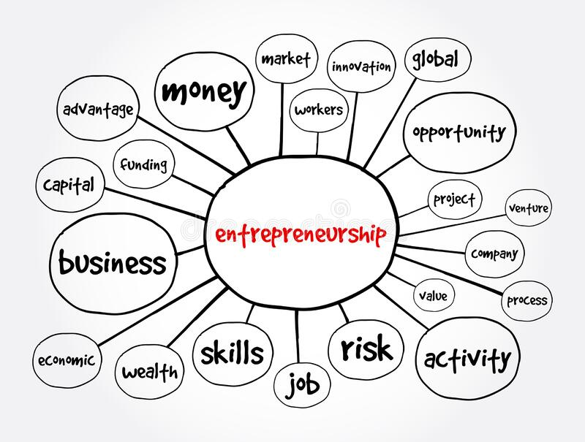

Slide 40
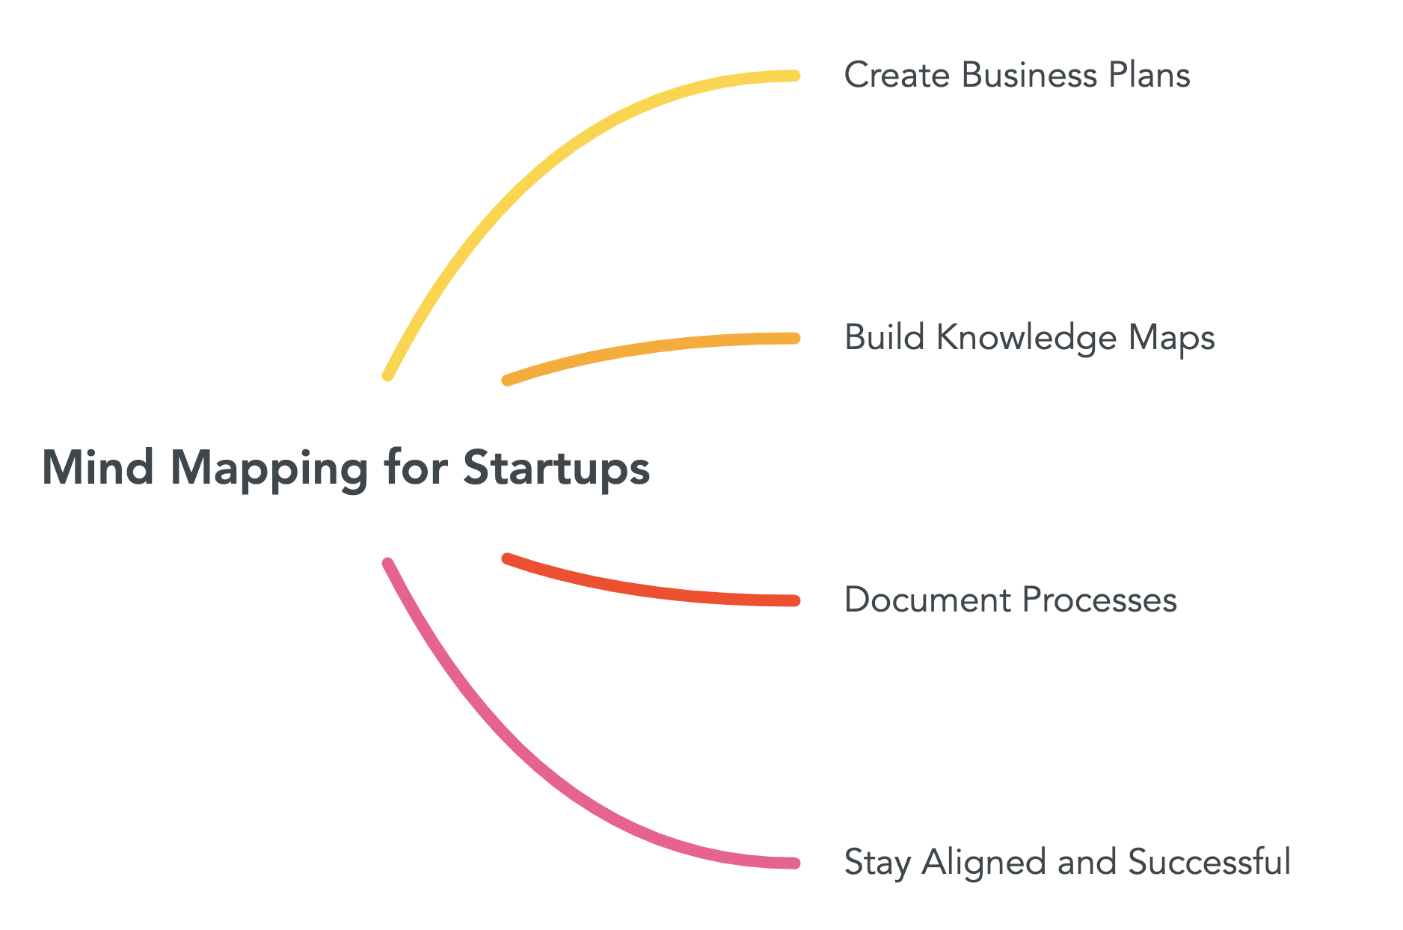
Mind Mapping

Slide 41
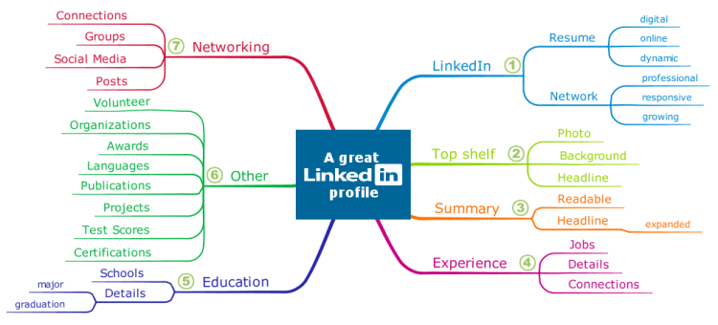
Mind Mapping

Slide 42
Reverse Engineering
Reverse engineering is a technique for understanding how something works
It involves taking something apart, analyzing its components, and identifying its strengths and weaknesses
Reverse engineering can help individuals and teams identify opportunities for improvement and innovation
It can be applied to software, hardware, and other products or services

Slide 43
Reverse Engineering
Let's say you're interested in creating a new project management tool for software development teams.
You want to create a tool that is more efficient and user-friendly than existing tools on the market.
Conduct a reverse engineering analysis of several popular project management tools, such as Asana, Trello, and Jira.
You could analyze their features, user interfaces, and workflows to identify areas for improvement.
Here are some potential insights you might gain from your reverse engineering analysis:
User Interface
Workflows
Integration
Automation

Slide 44
Starbursting
Starbursting is a variation of brainstorming that involves creating a visual representation of ideas
It involves drawing a central idea or concept, and then branching out into related ideas and sub-ideas
Starbursting can help individuals and teams generate a large number of ideas quickly and efficiently
It can be done individually or collaboratively

Slide 45
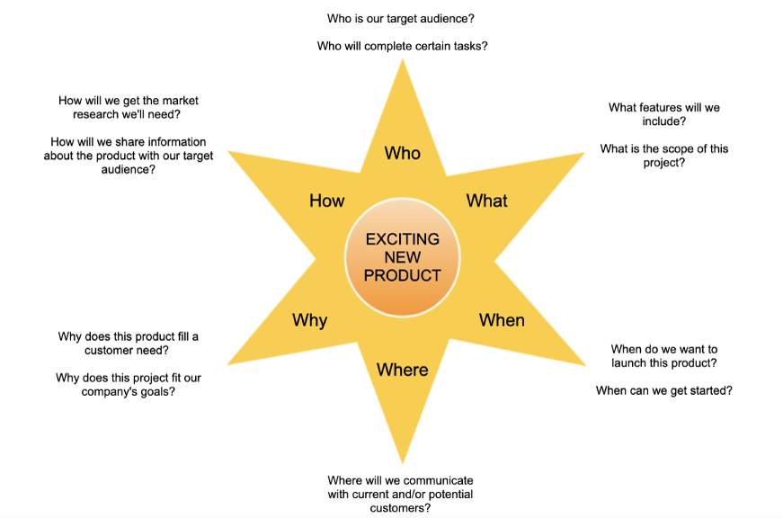

Slide 46
SCAMPER
SCAMPER is a mnemonic technique that stands for Substitute, Combine, Adapt, Modify, Put to Another Use, Eliminate, and Rearrange
It provides a structured approach to generating ideas, by applying different modifications to existing ideas or products
SCAMPER can help individuals and teams generate new ideas and solutions by building on existing knowledge and resources

Slide 47
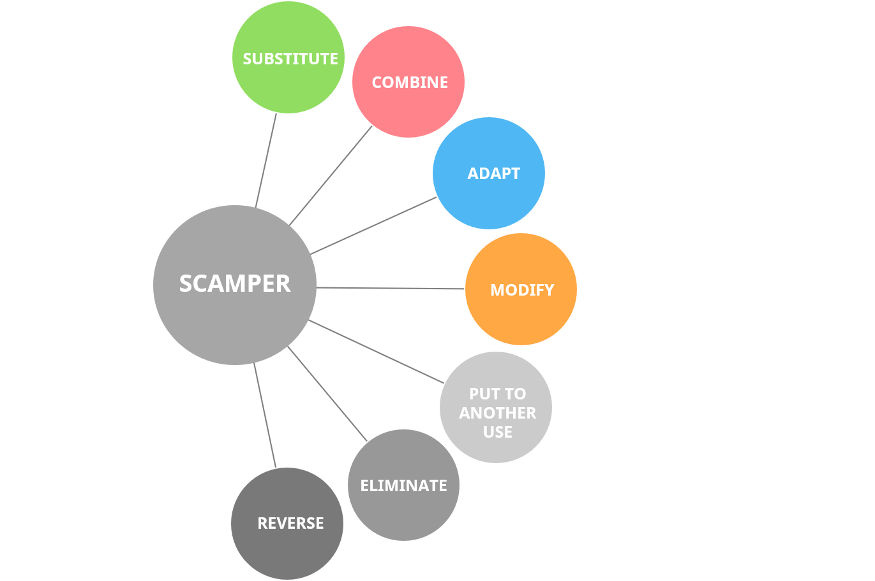

Slide 48
SCAMPER
Substitute:
What other technologies or services could be used to create a similar product or service?
What other markets or customer segments could be served?
What other business models could be used?
Combine:
How could the product or service be combined with other products or services to create something new or more valuable?
How could the product or service be combined with different business models?
How could the product or service be combined with different technologies or services?
Adapt:
How could the product or service be adapted to meet the needs of different markets or customer segments?
How could the product or service be adapted to different technologies or services?
How could the business model be adapted to different markets or customer segments?
Modify:
What features or functionality could be added or removed to make the product or service more appealing to customers?
How could the product or service be modified to make it more efficient or cost-effective to produce?
How could the business model be modified to make it more profitable or sustainable?

Slide 49
SCAMPER
Put to other uses:
Are there other ways to use the product or service that have not yet been thought of?
Are there other markets or customer segments that could benefit from the product or service?
Are there other ways to monetize the product or service?
Eliminate:
What features or functionality could be eliminated without sacrificing the value of the product or service?
What processes or steps could be eliminated to make the product or service more efficient or cost-effective to produce?
What costs could be eliminated without sacrificing the quality of the product or service?
Reverse:
How could the product or service be used to solve a problem in a new or different way?
How could the business model be reversed to create a new source of value?
What are the unintended consequences of the product or service, and how could they be exploited to create new opportunities?

Slide 50
Examples of Idea Generation Techniques
A company used brainstorming to generate ideas for a new product line, resulting in a successful launch
A startup used mind mapping to identify potential solutions for a complex problem, leading to a breakthrough in their product development
A team used reverse engineering to understand a competitor's product, identifying areas for improvement and innovation
An individual used starbursting to generate ideas for a new business venture, resulting in a successful pitch to investors
A group used SCAMPER to generate ideas for a new feature for their software product, leading to a significant increase in user engagement

Slide 51
Design Thinking

Slide 52
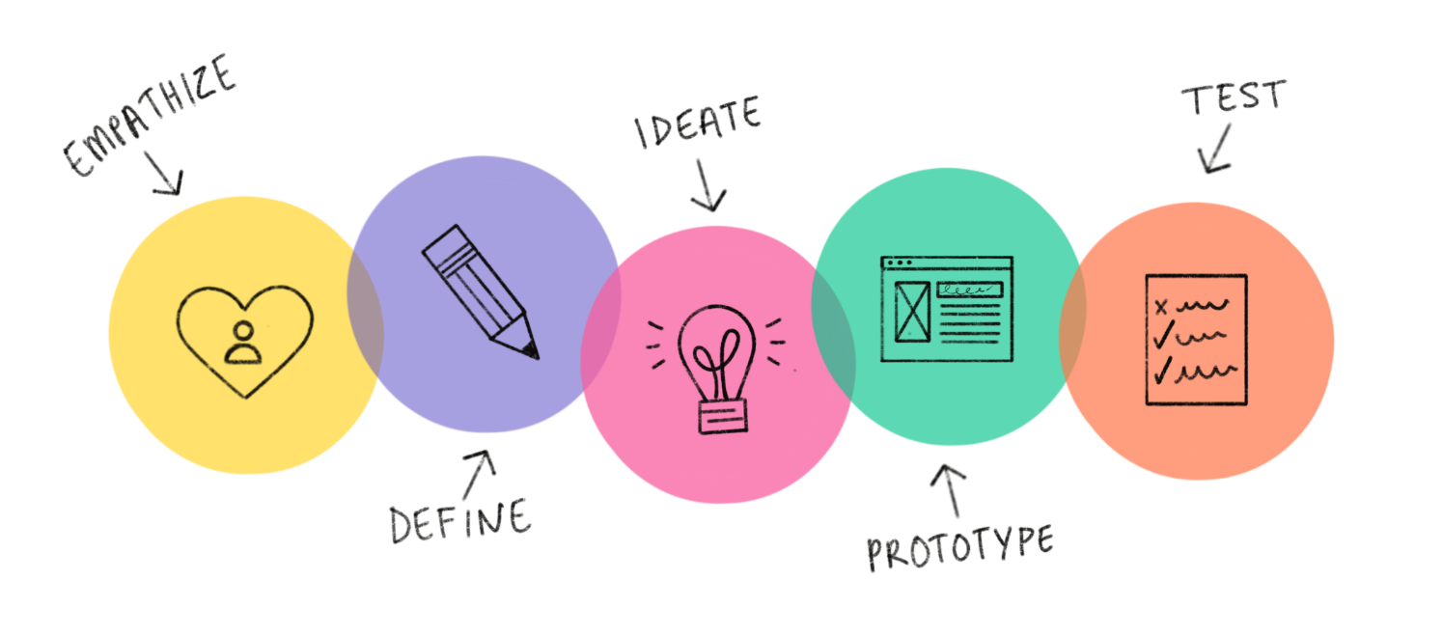
Design Thinking: A Problem-Solving Approach
Design thinking is a user-centered approach to problem-solving
It involves a iterative process of empathizing, defining, ideating, prototyping, and testing
Design thinking is used to create innovative solutions that meet user needs and solve real-world problems

Slide 53
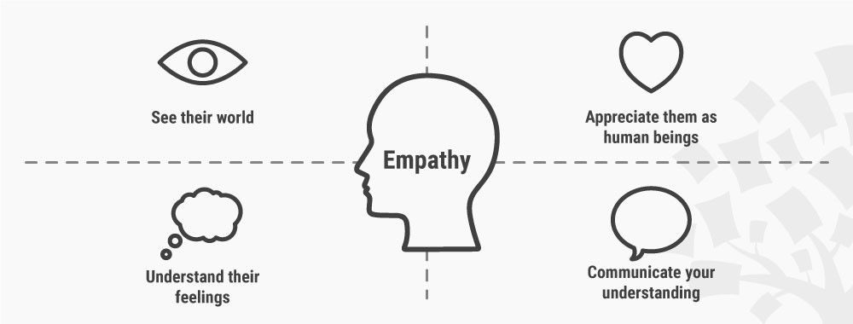
Empathize: Understanding User Needs
Involves understanding user needs and pain points
Conduct user research to gather data and insights
Create user personas to represent the user's perspective
Use empathy to develop a deep understanding of the user's needs and motivations

Slide 54
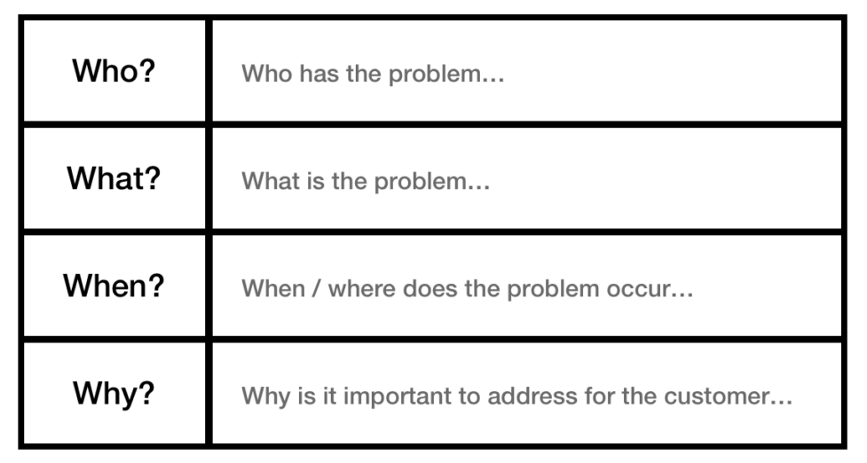
Define: Defining the Problem
Involves defining the problem statement or opportunity statement
Use the insights gathered during the empathize stage to identify the problem or opportunity
Define the problem or opportunity in a concise and actionable way
Use the problem or opportunity statement to guide the rest of the design thinking process

Slide 55
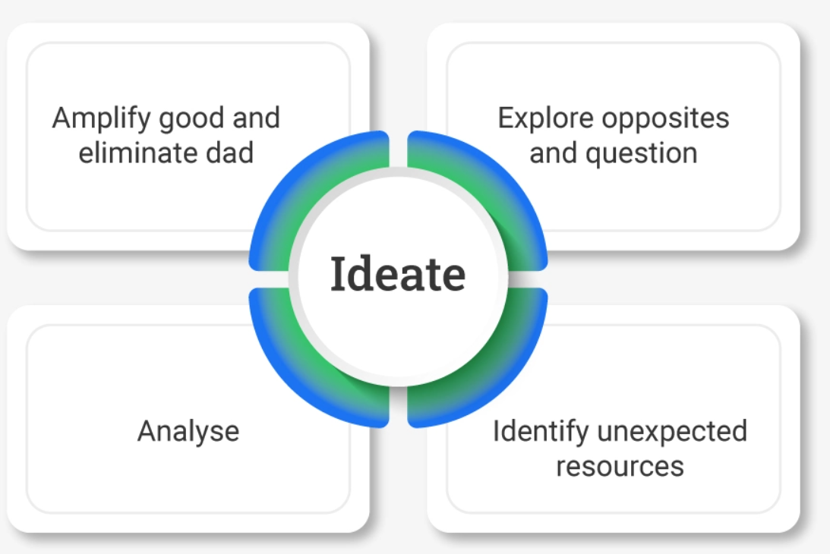
Ideate: Generating Ideas
Involves generating a wide range of ideas for solutions
Use brainstorming and other ideation techniques to generate ideas
Encourage wild and creative ideas, without worrying about feasibility or practicality
Use collaboration and building on others' ideas to foster a creative and supportive environment

Slide 56
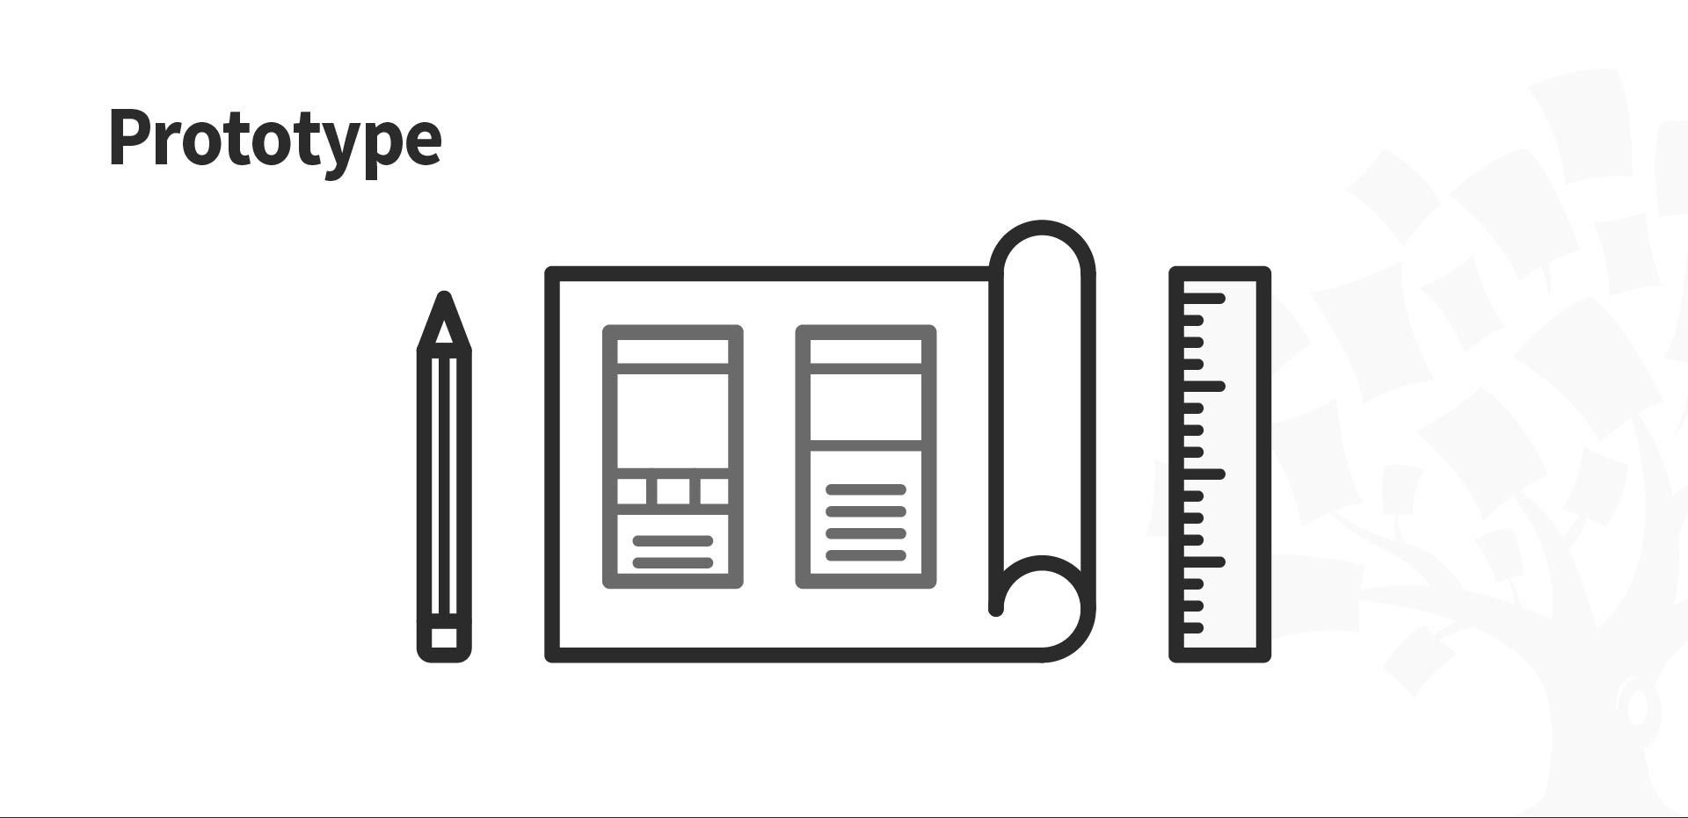
Prototype: Creating a Tangible Representation
Involves creating a tangible representation of the solution
Use prototyping to test and refine the solution
Create a prototype that is feasible, desirable, and viable
Use prototyping to gather feedback and refine the solution

Slide 57
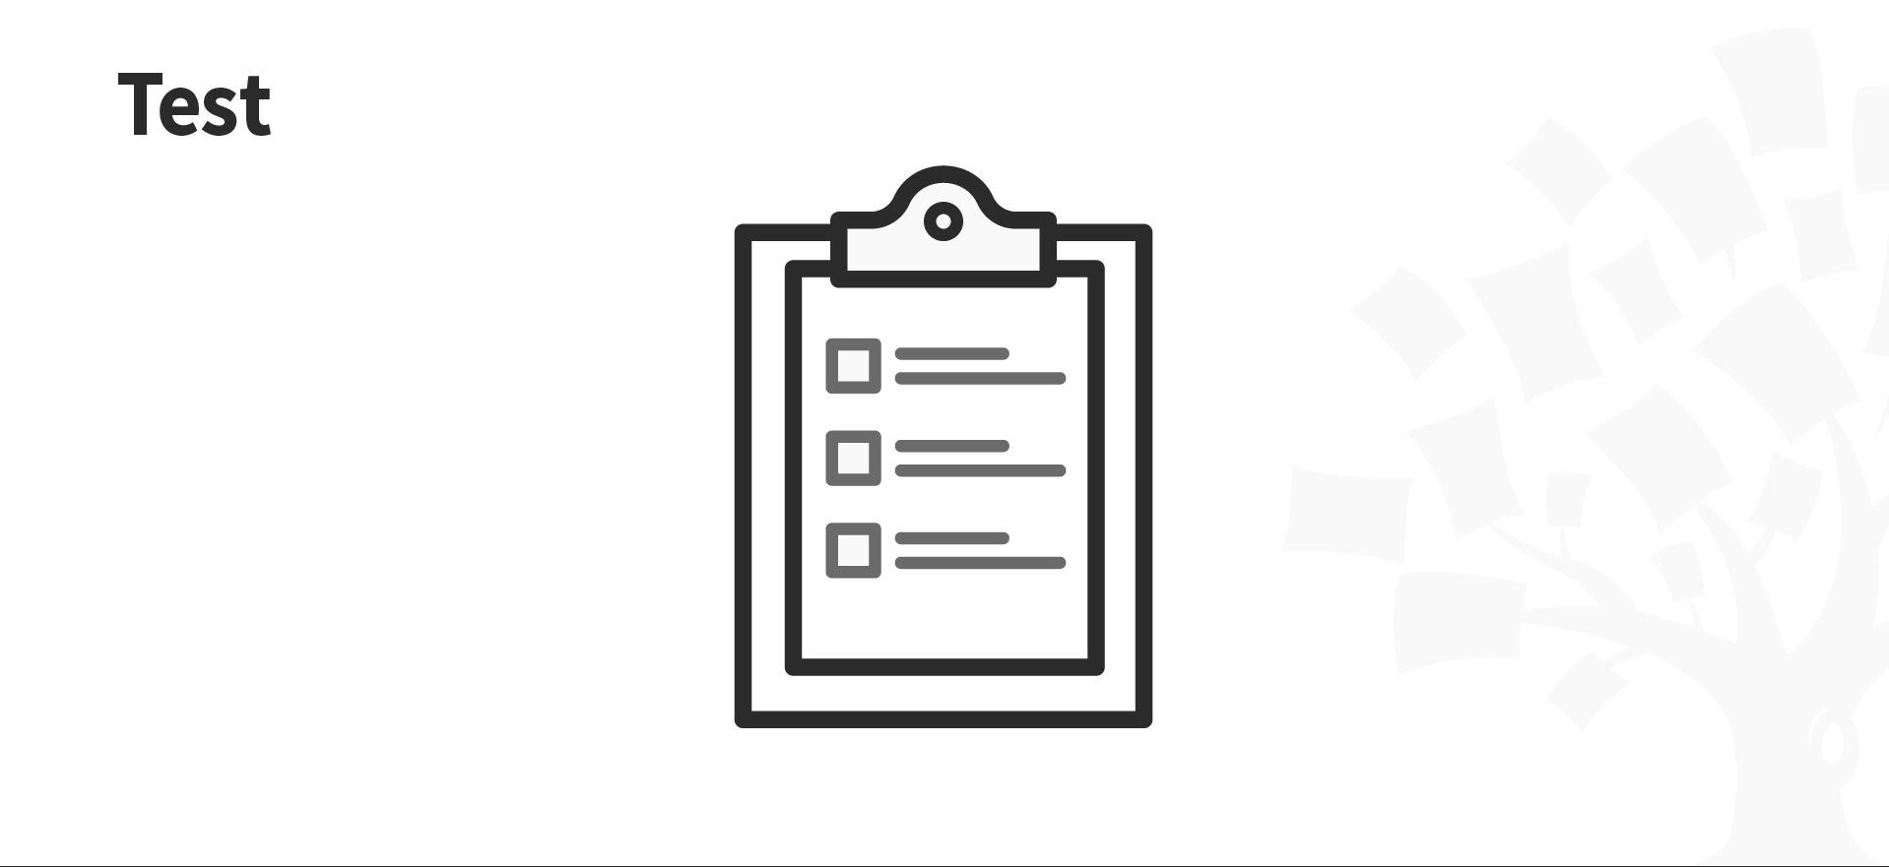
Test: Gathering Feedback and Refining the Solution
Involves testing the solution with users and gathering feedback
Use user feedback to refine and improve the solution
Conduct usability testing and gather feedback from users
Use the feedback to refine the solution and make it more user-friendly

Slide 58
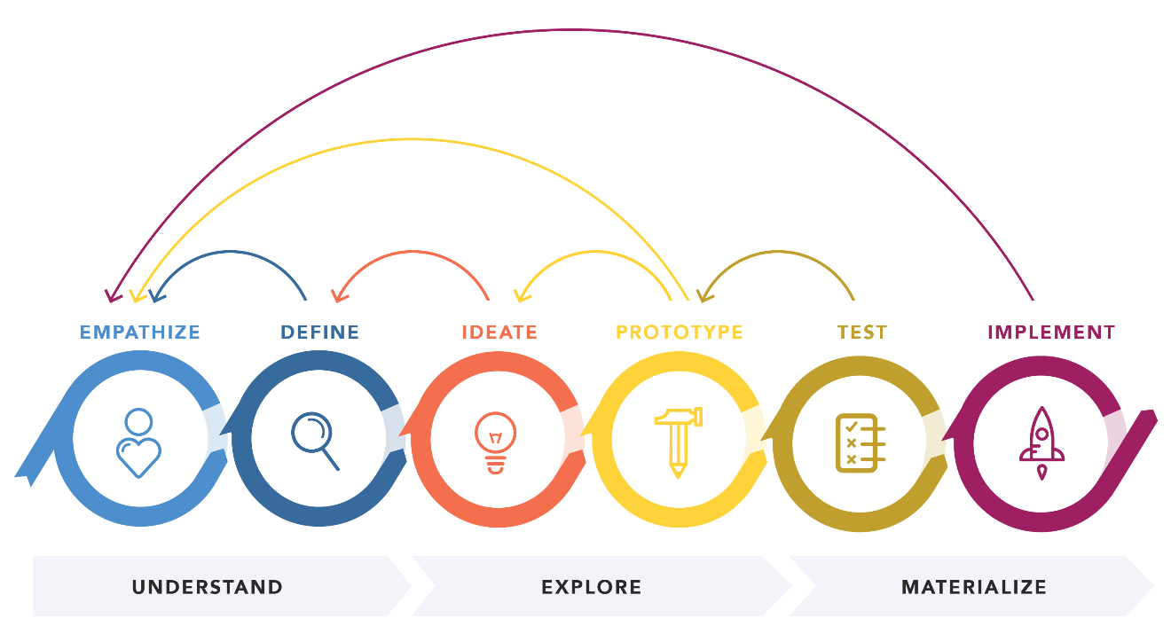
Iterate: Refining the Solution
Involves refining the solution based on user feedback
Use the feedback from the test stage to make improvements and refinements
Continue to iterate and refine the solution until it meets user needs and expectations
Use iteration to ensure that the
solution is feasible, desirable, and viable

Slide 59
User Experience (UX) Design

Slide 60
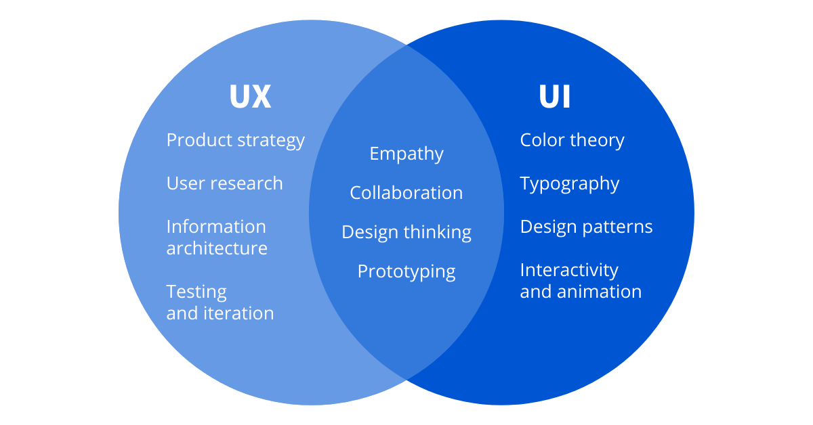
Creating Products That Delight and Engage Users
UX design is the process of creating products that are easy to use, efficient, and enjoyable for users
It involves understanding user needs, behaviors, and motivations to design products that meet their expectations
Good UX design can improve user satisfaction, increase customer loyalty, and ultimately drive business success

Slide 61
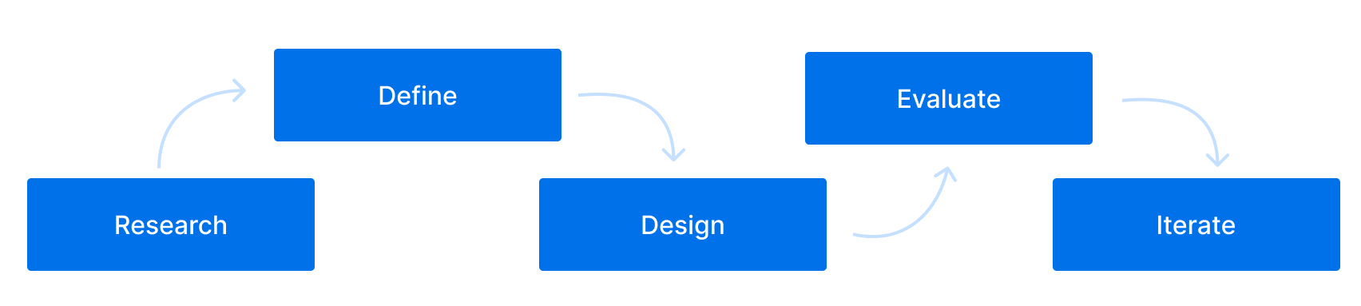
User-Centered Design Approach
User research: gather data about users' needs, behaviors, and motivations through interviews, surveys, and observations
User personas: create fictional representations of users to help designers and developers understand their target audience
User journey mapping: visualize the user's experience across different touchpoints and identify pain points and opportunities for improvement

Slide 62
User Interface (UI) Design
UI design is the process of creating the visual elements of a product, such as buttons, forms, and navigation
Good UI design should be intuitive, consistent, and visually appealing
Design principles: simplicity, clarity, hierarchy, balance, contrast, color theory, typography

Slide 63
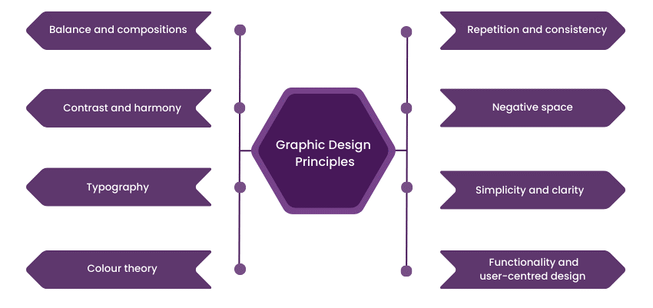
Graphic Design principles

Slide 64
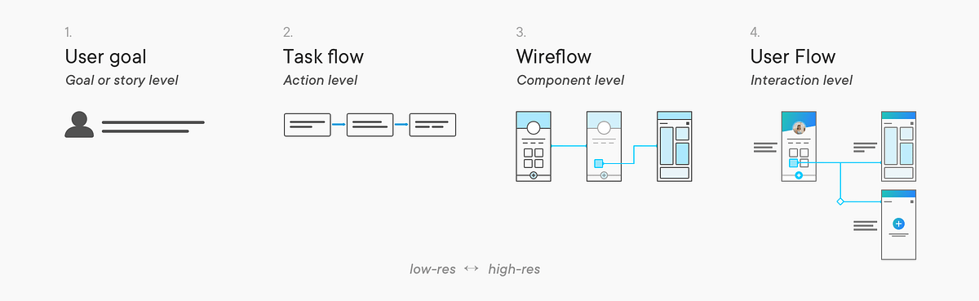
User Flows and Wireframes
User flows
a visual representation of the steps a user takes to complete a task or goal

Slide 65
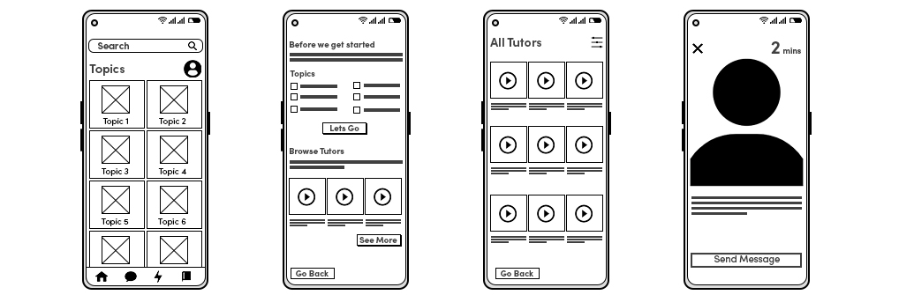
User Flows and Wireframes
Wireframes
a low-fidelity sketch of a product's layout and functionality

Slide 66
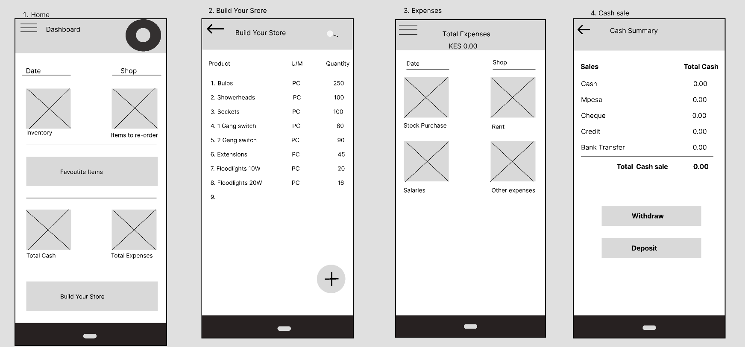
Information Architecture (IA)
IA is the process of organizing and structuring content in a way that makes it easy for users to find what they need
Good IA should have a clear hierarchy, logical navigation, and consistent labeling
Techniques: card sorting, site mapping, wireframing

Slide 67
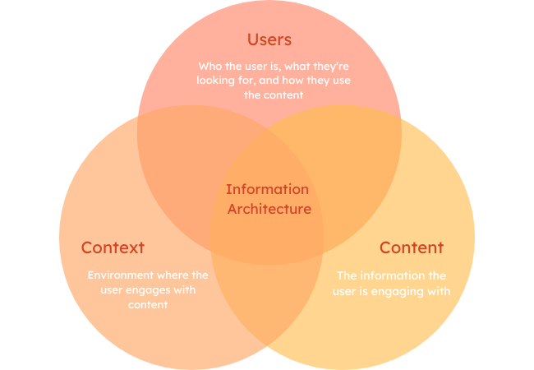
Information Architecture (IA)
Some key principles of IA include:
Consistency
Clarity
Hierarchy
Accessibility
Flexibility

Slide 68
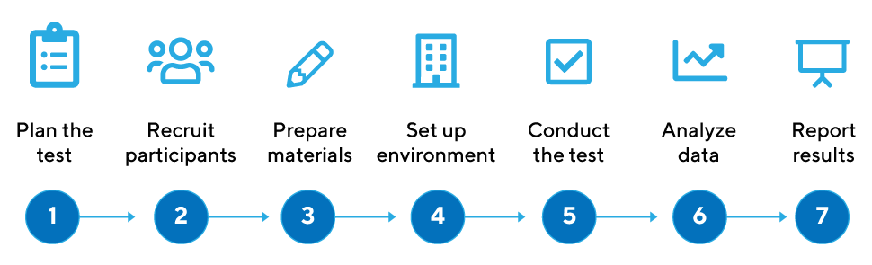
Usability Testing
Usability testing is the process of testing the product with real users to identify any usability issues or areas for improvement
Techniques: user testing, A/B testing, remote testing, guerilla testing
Goals: identify pain points, gather feedback, iterate and improve the design

Slide 69
Accessibility and Inclusive Design
Accessibility refers to the design of products that are accessible to users with disabilities
Inclusive design means designing products that are accessible and usable by as many people as possible, regardless of their abilities, language, culture, or location
Techniques: WCAG 2.1 guidelines, color contrast, font sizes, screen reader compatibility, keyboard navigation

Slide 70
Mobile and Responsive Design
Mobile design refers to the design of products for mobile devices, such as smartphones and tablets
Responsive design means designing products that adapt to different screen sizes and devices, without losing functionality or usability
Techniques: mobile-first design, responsive design frameworks, breakpoints, media queries

Slide 71
Design Tools and Software
Sketch
Figma
Adobe XD
InVision
Axure
Proto.io
Flinto

